Slide 1

ENGINEERING COLLEGE BIKANER
CORONA DATASET
TEAM MEMBERS:
ROHAN SINHA
DAYAWATI
TRAINER:
Ms. POONAM SHARMA

Slide 2
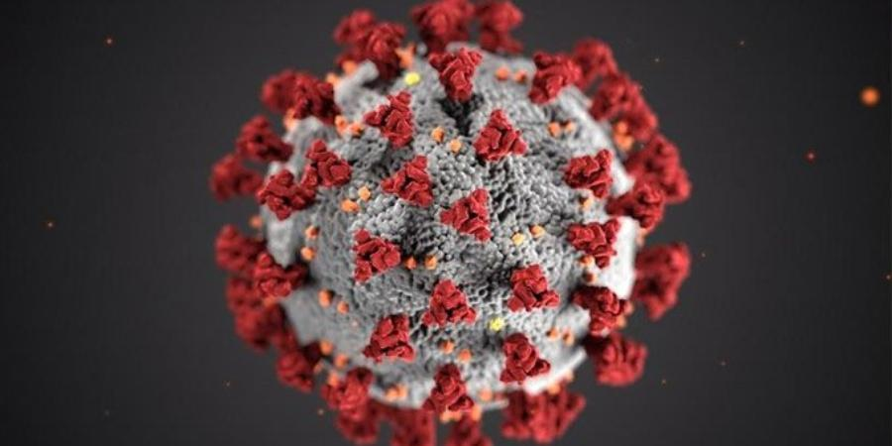
CORONAVIRUS :

Slide 3
CORONA DATASET
Ministry of Health & Family Welfare
Covid-19 India dataset
State wise testing details dataset
CSV file format
30-01-2020 - 02-09-2020

Slide 4
Techniques
Platform:
Google Colaboratory
Libraries:
Pandas
Matplotlib
Seaborn
Datetime
NumPy
Scikit-learn

Slide 5
Problem Statement
Visualize the top 3 COVID infected States and plot there case statistics.
Visualize the total testing done State wise.
From the given dataset ,training and testing the machine to predict the number of confirmed case on the specified date in a specified State.

Slide 6
Data Preprocessing
Manipulation of datasets to get the top confirmed cases State wise.
Visualization of the confirmed cases , death cases and cured cases of the COVID 19 state wise.
Visualization of the statistics progression of the top states confirmed cases , death cases of COVID -19 .
Visualization of the statistics progression of the total testing done for COVID -19 State wise.
Predict the future number of cases on a specific date of a specific state.

Slide 7

Model Accuracy:

Slide 8
Conclusions:
Basic understanding of the COVID -19 statistical approach in India.
Prediction of the future cases using basic machine learning.
Working on the real time Dataset.

Slide 9
Lets move to code
and do the practical
implementations.

